Slide 1
Rationale
Object-oriented concepts form the base of all modern programming languages. Understanding the basic concepts of object-orientation helps a developer use various modern day programming languages, more effectively. C++ is an object-oriented programming language that intends to be a simple, modern, and general-purpose programming language for application development.

Slide 2
Rationale (Contd.)
This course is applicable to students who want to enter the world of object-oriented programming by using the C++ language. This course provides a strong foundation in object-oriented programming approaches and in the fundamentals of C++ programming language.

Slide 3
Objectives
In this session, you will learn to:
Understand the concept of programming
Understand object-oriented programming
Understand C++ as an object-oriented language

Slide 4
Overview of Programming
Computer follows an Input-Process-Output cycle. It needs set of instructions called program to specify the input required, process to be followed, and the output required.
Program is written in a specific language called programming language, so that computer can understand the instructions.

Slide 5
Program
It is a set of instructions to perform a particular job.
Instructions in a program can be:
  Sequential: Instructions that are executed one after the other
  Decision making: Instructions that evaluate an expression first and then, depending upon whether the value of the expression is ‘true’ or ‘false’, it transfers the control to a particular statement
  Iterative: Instructions that are executed repeatedly, depending on the value of an expression

Slide 6
Programming Languages
Any instruction given to a computer must be a sequence of 0s and 1s.
A sequence of 0s and 1s can be used to describe any physical operation that the computer performs.
The two parts of a programming language instruction are:
  Operation code (opcode): This part instructs a computer about the operation to be performed.
  Operand: This part instructs the computer about the location of the data on which the operation specified by the opcode is to be performed.

Slide 7
Pseudocode
It is a detailed yet readable description of what an algorithm must do, expressed in a formally-styled natural language rather than in a programming language.
It is used as an initial step in the process of developing a program.

Slide 8
Pseudocode (Contd.)
Advantages of pseudocode are:
  It is easier and faster to write as it uses English like statements.
  It does not need to be rewritten if any changes are made because each step is independent and may be modified without altering the other steps.
  It can be converted to a program by using any programming language. This is because the format used by pseudocode is similar to a program. They both contain a set of sequential statements using a defined set of keywords.

Slide 9
Pseudocode (Contd.)
Limitations of pseudocode are:
  Pseudocode does not provide a graphical representation of an algorithm; therefore, it might be difficult to understand the complex logic in a pseudocode.
  Pseudocode depicting too many nested conditions may be difficult to understand.

Slide 10
Programming Approaches
Sequential approach:
  It includes programs that are actually a list of instructions to the system to perform a specific task.
  The limitation with this approach is that with an increase in the number of instructions, the program becomes too lengthy and complicated to understand.

Slide 11
Programming Approaches (Contd.)
Modular approach:
  It divides the programs into entities known as functions.
  The functions are clubbed together in logical groups with each group containing interrelated functions. Such logical groups are known as modules.
  Any change in the type or location of data requires a change in all the functions that access the data.
  It does not portray the real world and entities in the programs.

Slide 12
Programming Approaches (Contd.)
Object-oriented approach:
  It is the latest of the programming approaches and portrays the real world in the programs.
  It treats each entity as an object which has well‑defined state, behavior, and unique identity.
  It hides unnecessary details from the users and allows creation of programs that are easy to manage and maintain.

Slide 13
The Foundation of Object-Orientation
Objects: It is a tangible entity that may exhibit some well-defined behavior. For example:
  A tennis ball is a tangible, visible entity, which has a visible boundary.
  A tennis ball has a specific purpose.
  You can direct a specific action towards a tennis ball (hit it with a racquet and send it flying).

Slide 14
The Foundation of Object-Orientation (Contd.)
According to Grady Booch, an object has the following characteristics:
  It has a state.
  It may display a behavior.
  It has a unique identity.

Slide 15
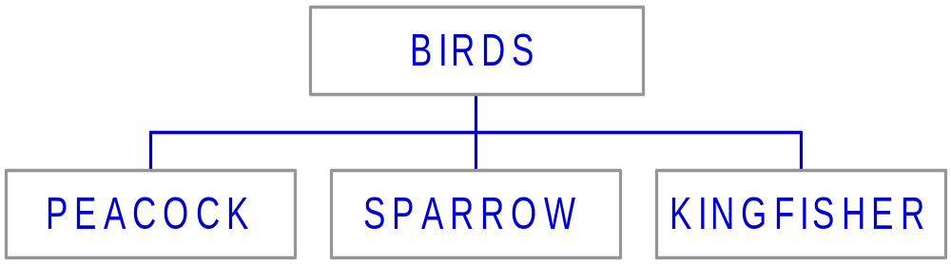
The Foundation of Object-Orientation (Contd.)
Classes:
  Define the attributes and behaviors of an object.
  For example, the peacock, the sparrow, and the kingfisher all share structural and behavioral similarities and belong to the class called Birds, as shown in the following figure.

Slide 16
The Foundation of Object-Orientation (Contd.)
Messages:
  Are transmitted by one object to another.
  Are transmitted as requests for an action to be taken.
  Are accompanied by additional information needed to carry out the request.
Methods:
  Are a set of actions taken by the receiver object in response to the request.

Slide 17
Benefits of the Object-Oriented Approach
Realistic modeling:
  Easy to use
Reusability:
  Saves time and cost
Resilience to change:
  Easy to maintain
  Parts of the system can be refined without any major change in other parts

Slide 18
Benefits of the Object-Oriented Approach (Contd.)
Existence as different forms:
  Objects can be made to respond differently to the same message.
  The response is decided based on the information or parameters provided with the message.

Slide 19
C++: An Object-Oriented Language
In the early 1980s, Bjarne Stroustrup working for Bell Labs developed the C++ language.
The main purpose of C++ is to make writing good programs easier and more pleasant for the individual programmer.
C++ was originally known as 'C with classes' as two languages contributed to its design:
  C: It provided low‑level features.
  Simula67: It provided the class concept.
C++ is an example of an object‑oriented language.

Slide 20
Classes in C++
Consider the following code snippet, which contains a class:
  class Car
  {
  public:
  void honk()
  {
  cout<<"BEEP BEEP!";
  }
  };

Slide 21
Classes in C++ (Contd.)
The class keyword:
  Is used to declare a class.
  For example:
  class Car
  {
  ...
};
  The class keyword is followed by the name of the class. In the above example, Car is the class name.

Slide 22
Classes in C++ (Contd.)
Class naming conventions in C++:
  A class name should be meaningful.
  A class name should ideally be a noun.
  First letter of every word in the class name should be in upper case.
Rules for naming classes in C++:
  Must not contain any embedded space or symbol
  Must begin with a letter, which may be followed by a sequence of letters or digits
  Cannot be a keyword

Slide 23
Classes in C++ (Contd.)
Member functions:
  Are means of passing messages and responding to them.
  Are declared inside the class body.
  For example:
  class Car
  {
  void honk()
  {
  cout<<"BEEP BEEP!";
  }
};

Slide 24
Classes in C++ (Contd.)
The cout object:
  Is an instance of the pre-defined class, ostream.
The endl manipulator:
  Is a command that takes the cursor to the new line.

Slide 25
Demo: Creating Classes in C++
Problem Statement:
  As a member of a team that is developing the billing system software for Diaz Telecommunications Inc., you have been assigned the task of creating a software module that accepts and displays customer details. Declare the Customer class and the member functions. The member function to accept customer details should display the message Accepting Customer Details. Similarly, the member function to display customer details on the screen should display the message Displaying Customer Details.

Slide 26
Summary
In this session, you learned that:
Program is written in a specific language called programming language, so that computer can understand the instructions.
The object-oriented approach views the systems as consisting of component objects and looks at the interactions between them.

Slide 27
Summary (Contd.)
An object is an entity that may have a physical boundary and is also characterized by:
  State
  Behavior
  Identity
A class consists of a set of objects that share a common structure and behavior.
If one object desires an action from another object, it sends a message to the second object.

Slide 28
Summary (Contd.)
The object that receives the message is called the receiver; the set of actions taken by the receiver constitutes the method.
The benefits of the object-oriented approach are:
  Realistic modeling, hence it is easier to use
  Reusability of code, hence it saves time and cost
  Resilience to change, hence systems are easier to maintain
  Existence in different forms, hence it allows objects to respond differently to the same message

Slide 29
Summary (Contd.)
Bjarne Stroustrup developed the C++ language in the early 1980s.

